Slide 1




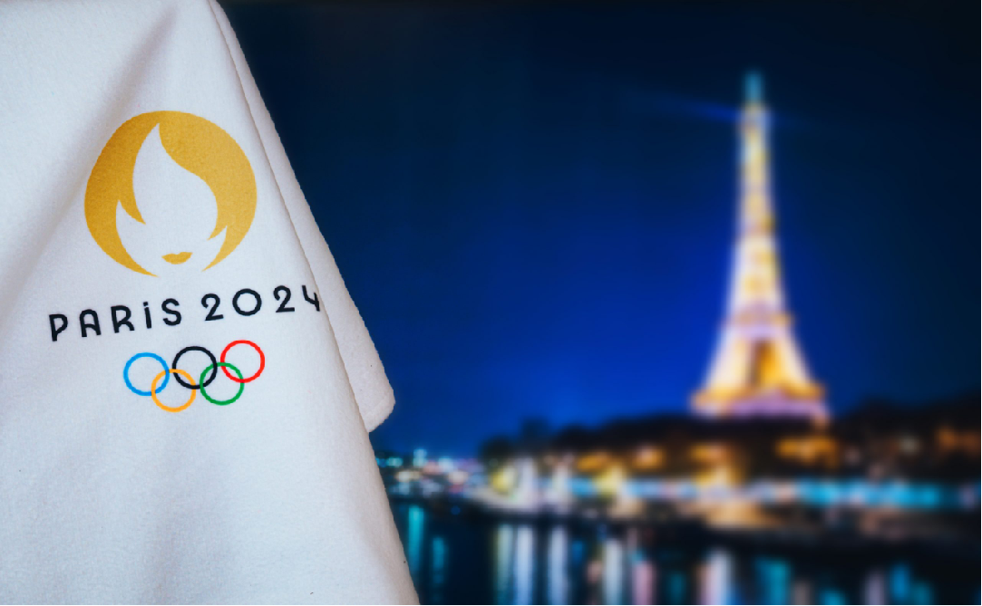

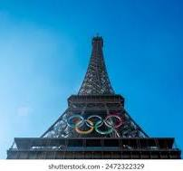


SENTIMENT ANALYSIS
1
Enter title
PART ONE

Slide 2


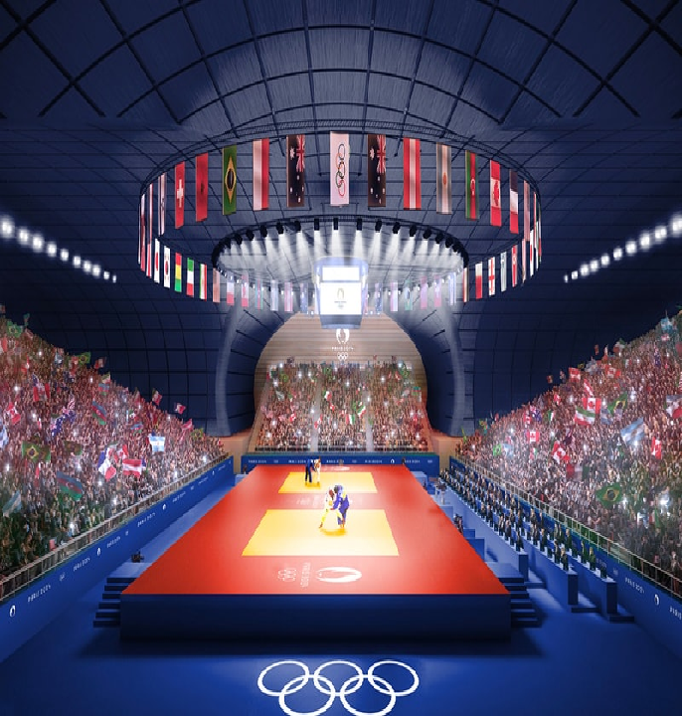
BUSINESS OVERVIEW
The Paris Olympics have attracted significant global attention on social media and analysing public sentiment can help enhance content, marketing strategies and event planning.

Slide 3


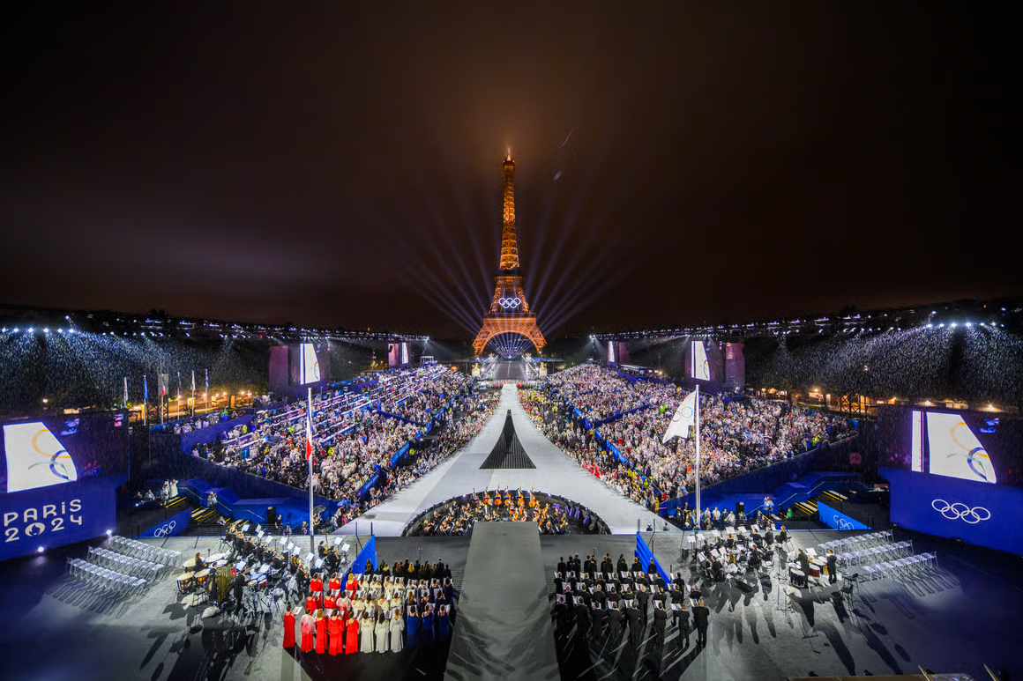
PROBLEM STATEMENT
The Paris Olympics generates complex social media data reflecting public sentiment, posing analysis challenges due to language and sentiment variations, yet crucial for accurate insights.

Slide 4

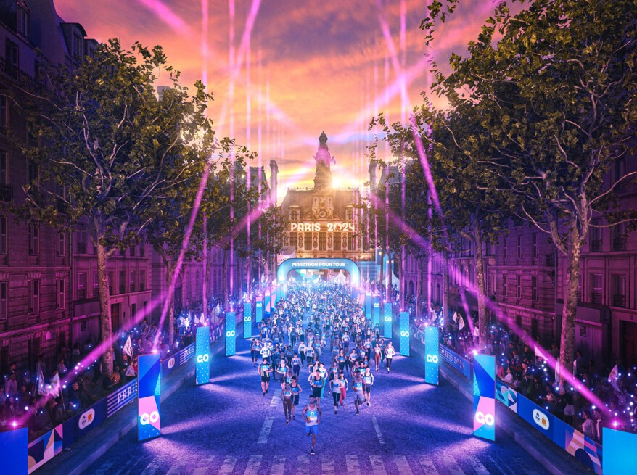
OBJECTIVES
Main Objective
Develop a comprehensive social media sentiment analysis model that accurately captures and interprets public sentiment about the Paris Olympics from social media data.
Specific Objectives
Extract, clean, and process multilingual social media data related to the Paris Olympics to address quality issues.
Develop NLP models and visualizations to analyse sentiment trends and provide actionable insights to stakeholders.

Slide 5
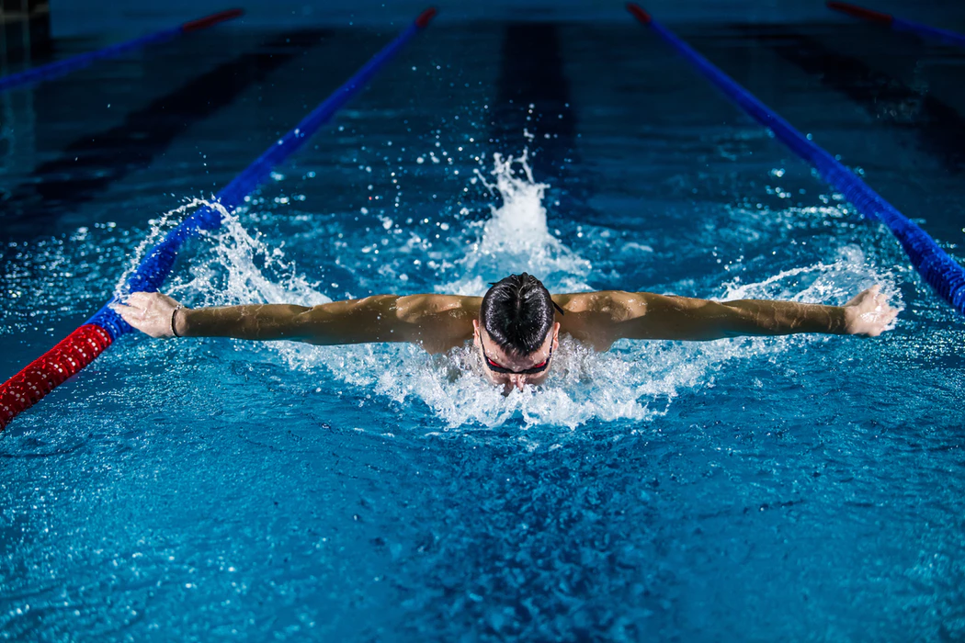
DATA UNDERSTANDING
Data Sources
Dataset
Relevance of the data
Our dataset has 15 columns;Hashtags, comments, and retweets discussing the Paris Olympics.
Extracted data from X using Octorparse Web scraping Tool.
Relevant hashtags allow for more targeted analysis potentially revealing topic-specific sentiments.

Slide 6



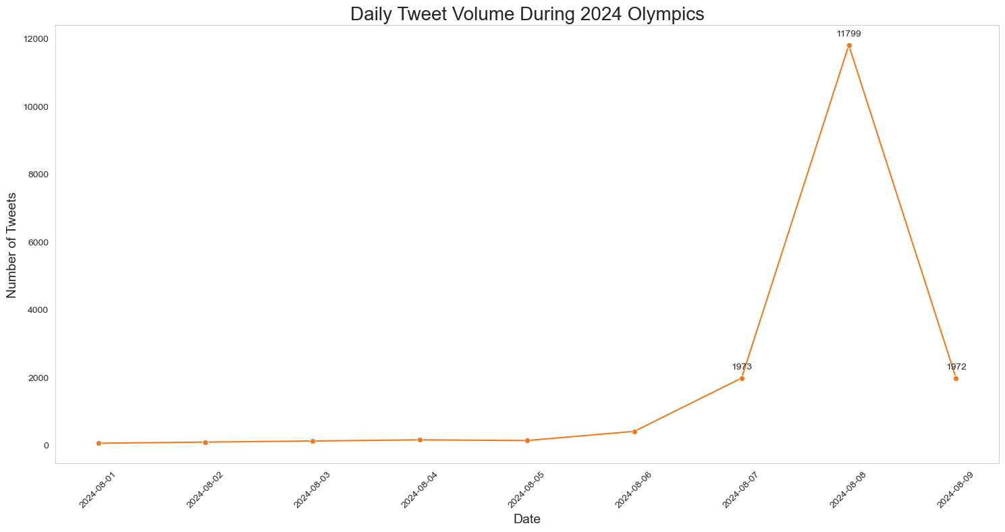
Tweet Volume During the Month Of August
A tweet spike on August 8, 2024, with 11,799 tweets, indicates a major event that day.
Tweet volume gradually increases before the peak, with notable jumps on August 6 and 7.

Slide 7
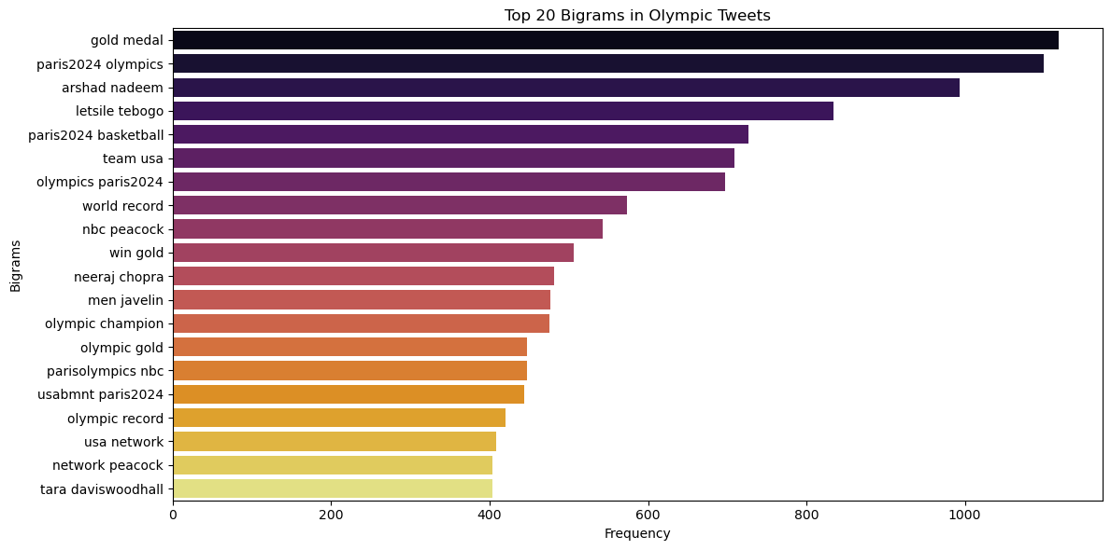
Analysis of Frequent Bigrams in the Dataset
Observation
The plot shows that common bigrams include "gold medal," "Paris 2024 Olympics," and "Arshad Nadeem," indicating key topics in the tweets.

Slide 8
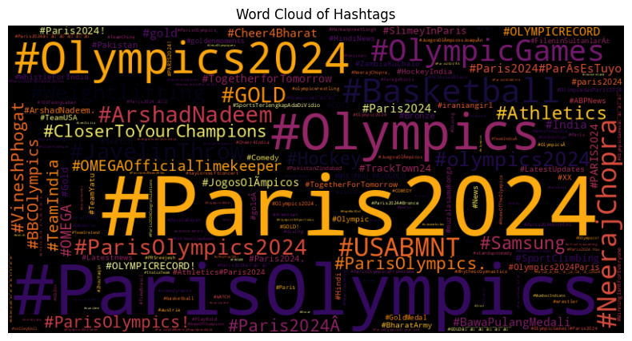
Most Prominent Hashtags During the Olympics
Observation
The word cloud shows "#Paris2024," "#ParisOlympics," and "#Olympics2024" as the top hashtags, highlighting the focus on the Paris 2024 Games, along with notable mentions like "#NeerajChopra" and "#Basketball."

Slide 9

RECOMMENDATIONS
1
Create a real-time sentiment tracking dashboard for organizers and media partners to swiftly respond to shifts in public opinion.
Develop a multilingual sentiment analysis feature using language-specific VADER versions to address the international nature of the Olympics.
2
3
Integrate sentiment analysis with other data sources, like ticket sales and TV ratings, to provide a comprehensive view of public engagement..
4
Use sentiment trends to inform content creation and social media strategies, highlighting themes and athletes that drive positive engagement.

Slide 10



NEXT STEPS
Step 1
Step 4
Enhance Feature Engineering: Add Olympics-specific features like mentions of sports, athletes, or events to boost classification accuracy.
Develop Interactive Dashboards: Create user-friendly dashboards for stakeholders to explore sentiment data in real-time.
Step 2
Step 5
. Develop Custom Olympic VADER Lexicon: Create a specialized VADER lexicon with Olympic-specific terms and their sentiment associations
Preprocess Multilingual Olympics Data: Fine-tune a model to accurately detect sentiment across various languages.
Step 3
Step 6
Extend Sentiment Analysis: Include multiple social media platforms and news sources for a comprehensive view.
Set Up Infrastructure for Post-Olympics Analysis: Track the lasting impact of the event on public sentiment towards Paris and the Olympic movement.

Slide 11


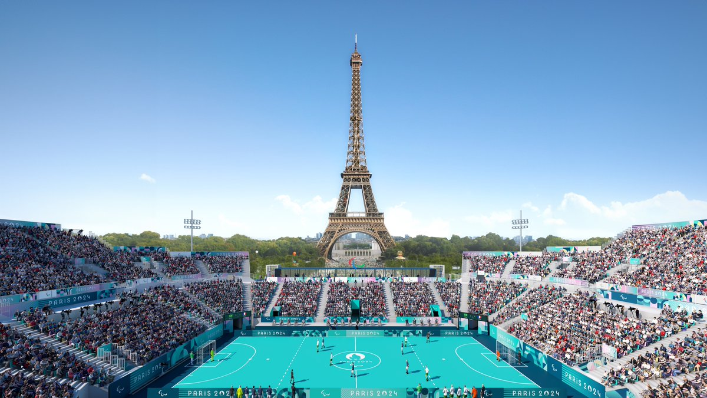



SPORT

